Slide 1
File Systems
1. Concept
2. Mounting file system
3. Basic concept
4.Root file system
5. Device file
6. Virtual file system (VFS)
7. Network file system (NFS)

Slide 2
Concept
File systems are used to organize data in directories and files on storage devices or on the network. The directories and files are organized as a hierarchy
Applications and users see a single global hierarchy of files and directories, which can be composed of several file systems
File systems are mounted in a specific location in this hierarchy of directories
This allows applications to access files and directories easily , regardless of their exact storage location

Slide 3
Mounting File System
Mount point is a directory, where a file system is mounted on, the content of this directory reflects the contents of the storage device
When the file system is unmounted , the mount points is empty again

Slide 4
mount / umount
mount allows to mount file systems
  mount -t type device mountpoint
  type is the type of file system
  device is the storage device, or network location to mount
  mountpoint is the directory where files of the storage device or network location will be accessible
  mount with no arguments shows the currently mounted filesystems
umount allows to unmount filesystems
  This is needed before rebooting, or before unplugging a USB key, because the Linux kernel caches writes in memory to increase performances. umount makes sure that those writes are committed to the storage.

Slide 5
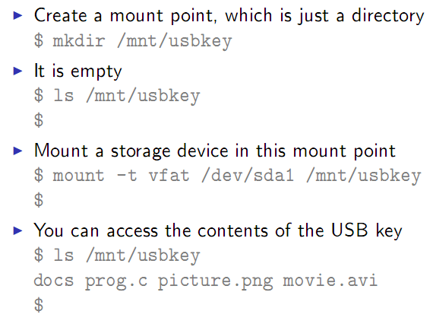
Mount example

Slide 6
Root filesystem
A particular filesystem is mounted at the root of the hierarchy, identified by /
It is mounted directly by the kernel, according to the root= kernel option
It can be mounted from different locations: hard disk, USB, SD card, storage device(NAND flash), network(NFS protocol), memory(bootloader)

Slide 7
Important directory
/bin Basic programs
/boot Kernel image (only when the kernel is loaded from a file system, not common on non-x86 architectures)
/dev Device files (covered later)
/etc System-wide configuration
/home Directory for the users home directories
/lib Basic libraries
/media Mount points for removable media
/mnt Mount points for static media
/proc Mount point for the proc virtual file system
/root Home directory of the root user
/sbin Basic system programs
/sys Mount point of the sysfs virtual _x000c_filesystem
/tmp Temporary files
/usr /usr/bin Non-basic programs
/usr/lib Non-basic libraries
/usr/sbin Non-basic system programs
/var Variable data files. This includes spool directories and files, administrative and logging data, and transient and temporary files

Slide 8
Device file
Linux design decision was to represent most of the "system objects" as files
It allows applications to manipulate all "system objects" with the normal file API (open, read, write, close, ...)
devices had to be represented as files to the applications
It is a special type of file, that associates a file name visible to user space applications to the triplet (type, major, minor) that the kernel understands
All device files are by convention stored in the /dev directory
Notes:
In the Linux kernel, most devices are presented to userspace applications through two different abstractions
Block device:
A device composed of fixed-sized blocks, that can be read and written to store data
Used for hard disks, USB keys, SD cards, etc.
- Character device
Originally, an infinite stream of bytes, with no beginning, no end, no size. The pure example: a serial port.
Used for serial ports, terminals, but also sound cards, video acquisition devices, frame buffers
Most of the devices that are not block devices are represented as character devices by the Linux kernel
Internally, the kernel identifies each device by a triplet of information
-Type (character or block)
-Major (typically the category of device)
-Minor (typically the identifier of the device)

Slide 9
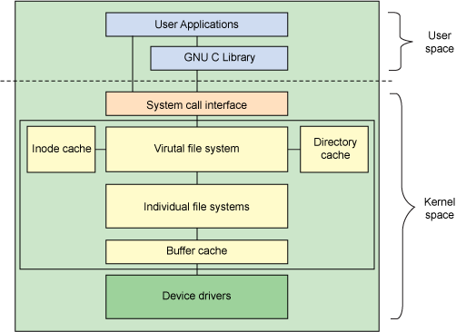
Virtual file system
Notes:
A virtual file system (VFS) is an abstraction layer that resides above a file system and provides an interface between the kernel and the file system. Through a VFS, client applications can access different file systems.
Provides support for many different kinds and types of file systems
During the initialization of each file system, the file system registers itself with the VFS. This occurs as the operating system initializes itself at startup. The real file systems are generally built as loadable modules or built directly into the kernel. For instance, the VFS can access local and network storage devices transparently without the client application knowing the actual file systems
The two most important virtual filesystems are
- proc, usually mounted on /proc: Operating system related information (processes, memory management parameters...)
- sysfs, usually mounted on /sys: Representation of the system as a set of devices and buses. Information about these devices.

Slide 10
Virtual file system
proc file system allows:
  The kernel to expose statistics about running processes in the system
  The user to adjust at runtime various system parameters about process management, memory management…
The proc file system is used by many standard user space applications, and they expect it to be mounted in /proc
sysfs file system allows to represent in user space the vision that the kernel has of the buses, devices and drivers in the system
It is useful for various user space applications that need to list and query the available hardware
All applications using sysfs expect it to be mounted in the /sys directory
Notes:
The proc virtual filesystem exists since the beginning of Linux
Proc file system allows:
The kernel to expose statistics about running processes in the system
The user to adjust at runtime various system parameters about process management, memory management…
The proc file system is used by many standard user space applications, and they expect it to be mounted in /proc
Applications such as ps or top would not work without the Proc file system
Command to mount /proc:
mount -t proc nodev /proc
The sysfs file system is a feature integrated in the 2.6 Linux kernel
sysfs file system allows to represent in user space the vision that the kernel has of the buses, devices and drivers in the system
It is useful for various user space applications that need to list and query the available hardware, for example udev or mdev
All applications using sysfs expect it to be mounted in the /sys directory
Command to mount /sys:
mount -t sysfs nodev /sys

Slide 11
Network File System
NFS allows a server to share directories and files with clients over a network.
users and programs can access files on remote systems as if they were stored locally.

Slide 12
File system type
ext2
ext3
ext4
reiserfs
btrfs
xfs
zfs
Notes:
The ext2 file system is Linux' old, yet still used file system. It stands for extended 2 file system and is quite simple. It has been in use almost since the birth of Linux and is quite resilient against file system fragmentation - although this is true for almost all Linux file systems. It is however slowly being replaced by journalled file systems.
The ext3 file system is an improvement on the ext2 file system, adding, amongst other things, the concept of journalling.
The ext4 file system is an improvement on the ext3 file system, adding, amongst other things, support for very large file systems/files, extents (contiguous physical blocks), pre-allocation and delayed allocation and more. The ext4 file system is backwards compatible with ext3 as long as you do not use extents. Ext4 is frequently seen as the default file system of choice amongst administrators and distributions.
The reiserfs file system is written from scratch. It provides journalling as well, but its main focus is on speed. The file system provides quick access to locations with hundreds of files inside (ext2 and ext3 are much slower in these situations) and keeps the disk footprint for small files small (some other file systems reserve an entire block for every file, reiserfs is able to share blocks with several files). Although quite popular a few years back, the file system has been seeing a lack of support through its popular years (harmful bugs stayed in for quite some time) and is not frequently advised by distributions any more. Its successor, reiser4, is still quite premature and is, due to the imprisonment of the main developer Hans Reiser, not being developed that actively any more.
The btrfs file system is a promising file system. It addresses concerns regarding huge storage backend volumes, multi-device spanning, snapshotting and more. Although its primary target was enterprise usage, it also offers interesting features to home users such as online grow/shrink (both on file system as well as underlying storage level), object-level redundancy, transparent compression and cloning.
The xfs file system is an enterprise-ready, high performance journaling file system. It offers very high parallel throughput and is therefore a common choice amongst enterprises.
The zfs file system (ZFSonLinux) is a multi-featured file system offering block-level checksumming, compression, snapshotting, copy-on-write, deduplication, extremely large volumes, remote replication and more. It has been recently ported from (Open)Solaris to Linux and is gaining ground.

Slide 13
File system type
proc
sysfs
tmpfs
devtmpfs
devpts
usbfs
selinuxfs
mqueue
binfmt_misc
Notes:
proc is a special file system which doesn't exist on a device, but is a sort of gateway to the Linux kernel. Everything you see below /proc is something the kernel displays the moment you read it. It is a way to communicate with the kernel (and vice versa) using a very simple interface: file reading and file writing, something well supported. proc is known to be a pseudo file system: it does not contain real files, but runtime information.
sysfs is a special file system just like proc: it doesn't exist on a device, and is a sort of gateway to the Linux kernel. It differs from proc in the way it is programmed as well as structured: sysfs is more structured and tailored towards computer-based parsing of the files and directories, whereas proc is more structured and tailored towards human-based reading/writing to the files and directories.
tmpfs is a temporary file system. Its contents is stored in memory and not on a persistent disk. As such, its storage is usually very quick (memory is a lot faster than even the fastest SSDs and hard disks out there). I do say usually, because tmpfs can swap out pages of its memory to the swap location, effectively making those parts of the tmpfs file system slower (as they need to be read from disk again before they can be used).
Within Linux, tmpfs is used for things like the shared memory in /dev/shm and /tmp.
devtmpfs is similar to the tmpfs file system, but contains device files managed by the kernel. The devtmpfs file system was brought to life to handle the concern of providing important device files before udev (the device manager) is able to start up and take control.
devpts is a pseudo file system like proc and sysfs. It contains device files used for terminal emulation (like getting a console through the graphical environment using xterm, uxterm, eterm or another terminal emulation program). In earlier days, those device files were created statically, which caused most distributions to allocate a lot of terminal emulation device files (as it is difficult to know how many of those emulations a user would start at any point in time). To manage those device files better, a pseudo file system is developed that creates and destroys the device files as they are needed.
usbfs is also a pseudo file system and can be compared with devpts. It also contains files which are created or destroyed as USB devices are added or removed from the system. However, unlike devpts, it doesn't create device files, but pseudo files that can be used to interact with the USB device.
As most USB devices are generic USB devices (belonging to certain classes, like generic USB storage devices) Linux has developed a framework that allows programs to work with USB devices based on their characteristics, through the usbfs file system.
selinuxfs is a pseudo file system that represents the SELinux subsystem in the Linux kernel. It is used by the SELinux libraries to interact with the SELinux security server, querying the SELinux policy and more. Linux systems that do not have SELinux enabled will not have this file system mounted.
mqueue is a pseudo file system used for inter-process message queue support (POSIX message queues)
binfmt_misc is a pseudo file system used to register executable formats. Through binfmt, the Linux kernel is able to execute arbitrary executable file formats by recognizing the registered executable formats and passing it on to userspace applications.

